Slide 1

Fashion Trend Analysis and Business Trends
Sakshi Sanjay Dudhal
Kaustubh Arun Pasalkar
Adhoksh Milind Sonawane

Slide 2

Objective and Significance
Explore Customer Behavior
Forecast Future Sales
Our analysis will help predict upcoming sales and revenue trends.
We'll delve into purchase patterns to understand our customers better.
Improve Marketing Strategies
Data-driven insights will shape more effective marketing campaigns.

Slide 3





Data Sources and Information
Customers Dataset
Orders Dataset
Comprehensive customer profiles including demographics and purchase history.
Detailed order information with dates, quantities, and product details.
Products Dataset
Sales Dataset
Complete product catalog with descriptions, prices, and categories.
Revenue data broken down by product, region, and time period.

Slide 4





Data Wrangling Process
Duplicate and Missing Value Check
Identified and addressed data inconsistencies to ensure accuracy.
Data Correction
Replaced extreme values and standardized formats across datasets.
Date Conversion
Transformed order dates into datetime format for temporal analysis.
Dataset Merger
Combined all datasets to create a comprehensive analysis table.

Slide 5
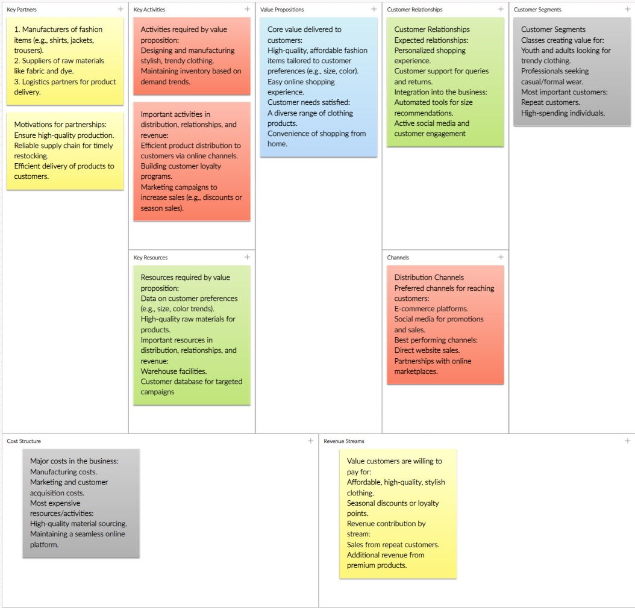

Slide 6



Exploratory Data Analysis Focus
Customer Insights
1
Status and age distribution analysis.
Financial Performance
2
Revenue distribution and sales by state.
Product Analysis
3
Identifying top-selling items and trends.

Slide 7
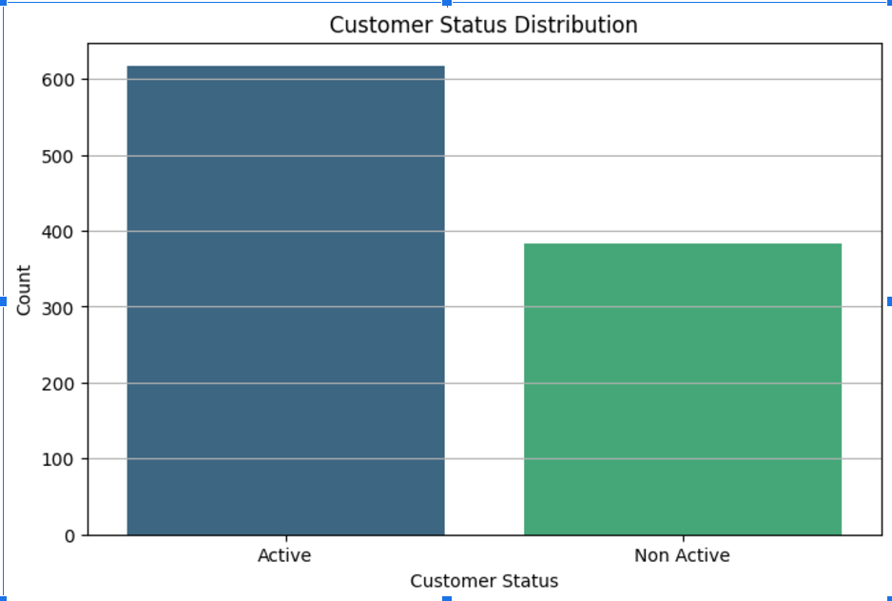
Customer Status Distribution
Active Customers
Non-Active Customers
The majority of our customer base is actively engaging with our products and services.
A significant portion of customers are inactive, presenting a re-engagement opportunity.

Slide 8

Customer Age Distribution
Adults Dominate
Marketing Focus
The "Adults" age group forms the largest segment of our customer base.
This insight guides our primary target demographic for marketing efforts.
Age-Specific Strategies
Tailored approaches for different age groups can enhance engagement across segments.

Slide 9
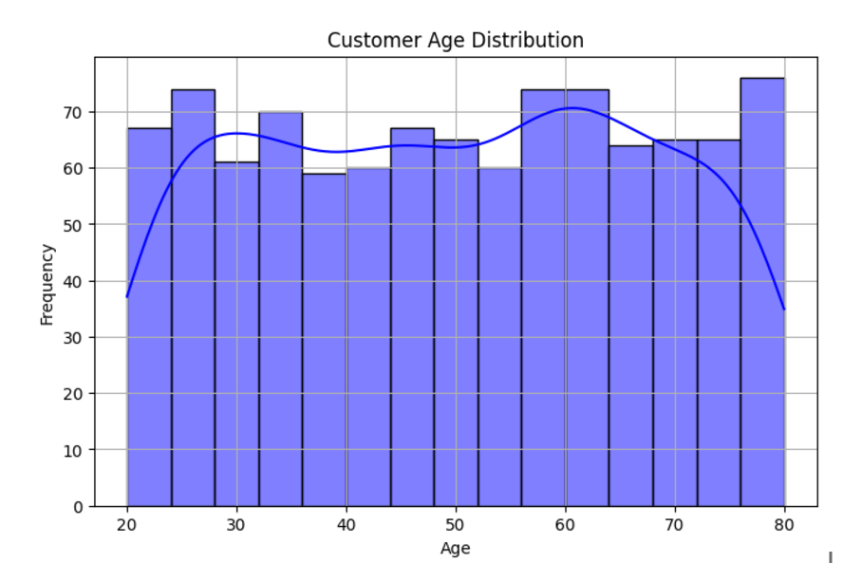

Slide 10
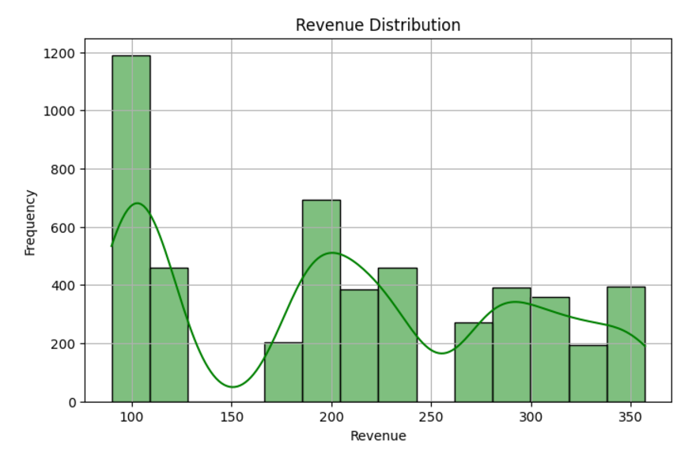

Slide 11
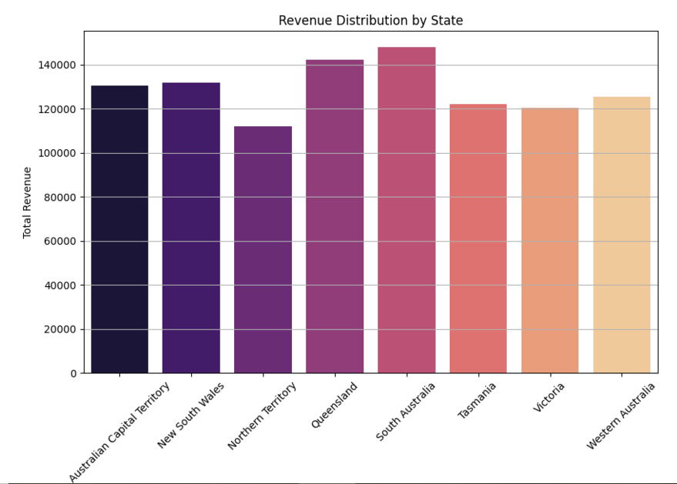

Slide 12
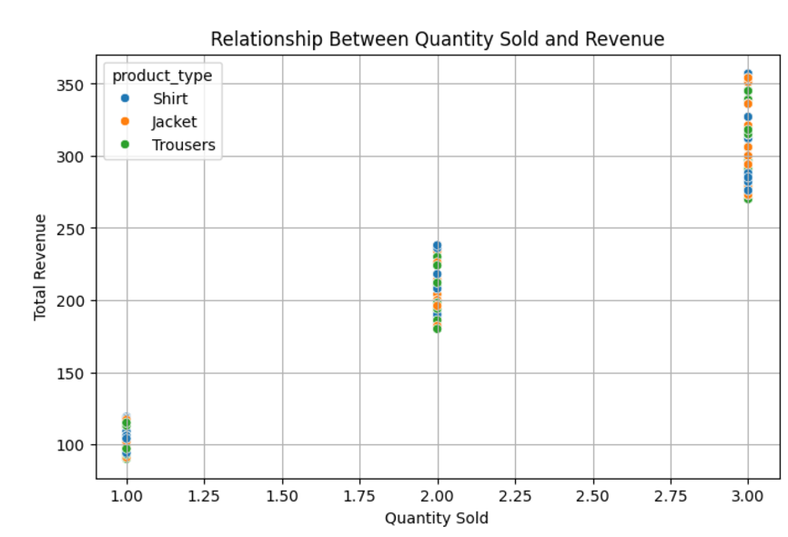

Slide 13
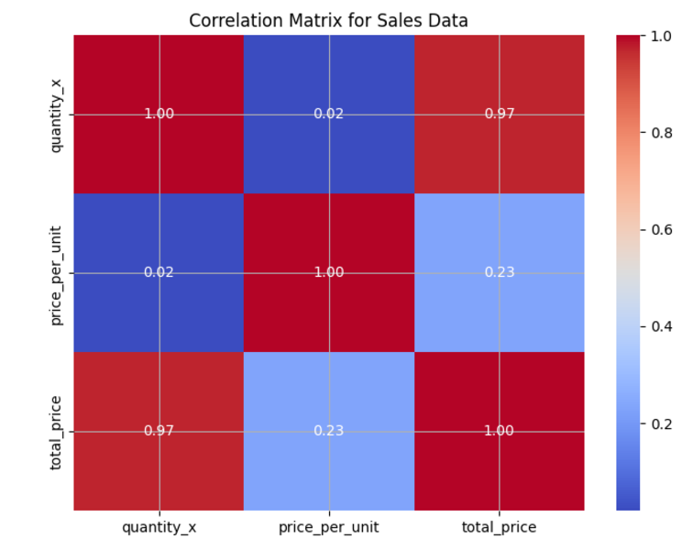

Slide 14
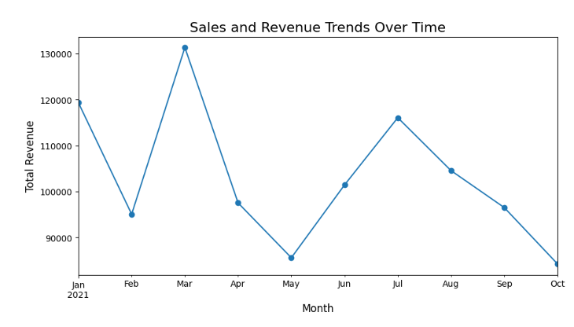

Slide 15
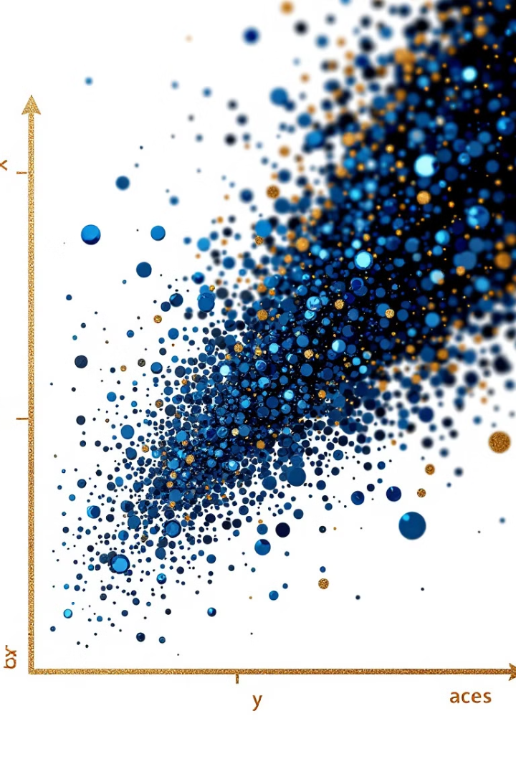
Revenue and Quantity Correlation
Positive Correlation
Higher quantities sold result in increased revenue
Linear Relationship
Strong positive trend visible in scatter plot

Slide 16

Feature Correlations Unveiled
Strong Positive Correlation
Total price and quantity closely linked
Insight Discovery
Heatmap reveals hidden relationships between variables

Slide 17
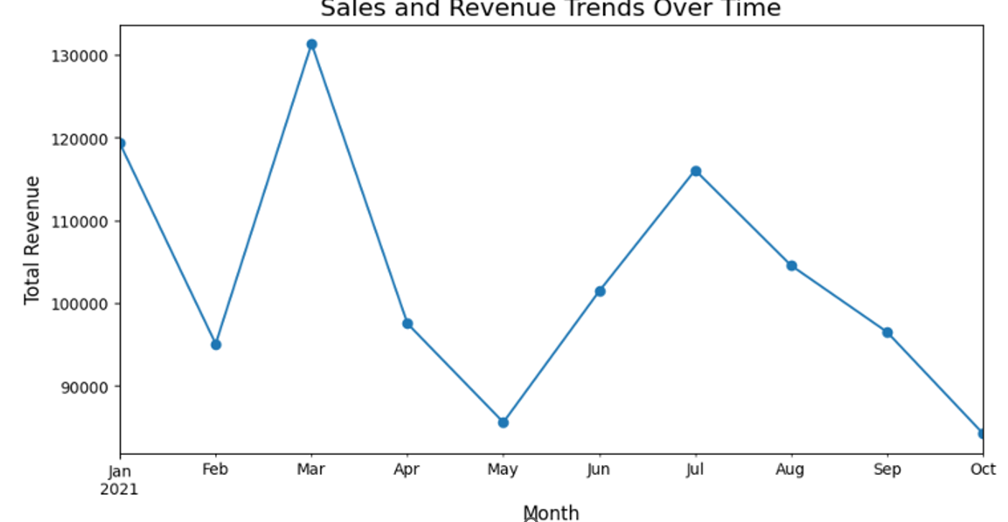
Sales and Revenue Trends
1
Peak in March
Highest revenue point of the year
2
Significant Drops
Opportunities to boost off-peak sales
3
Monthly Fluctuations
Clear patterns for strategic planning

Slide 18
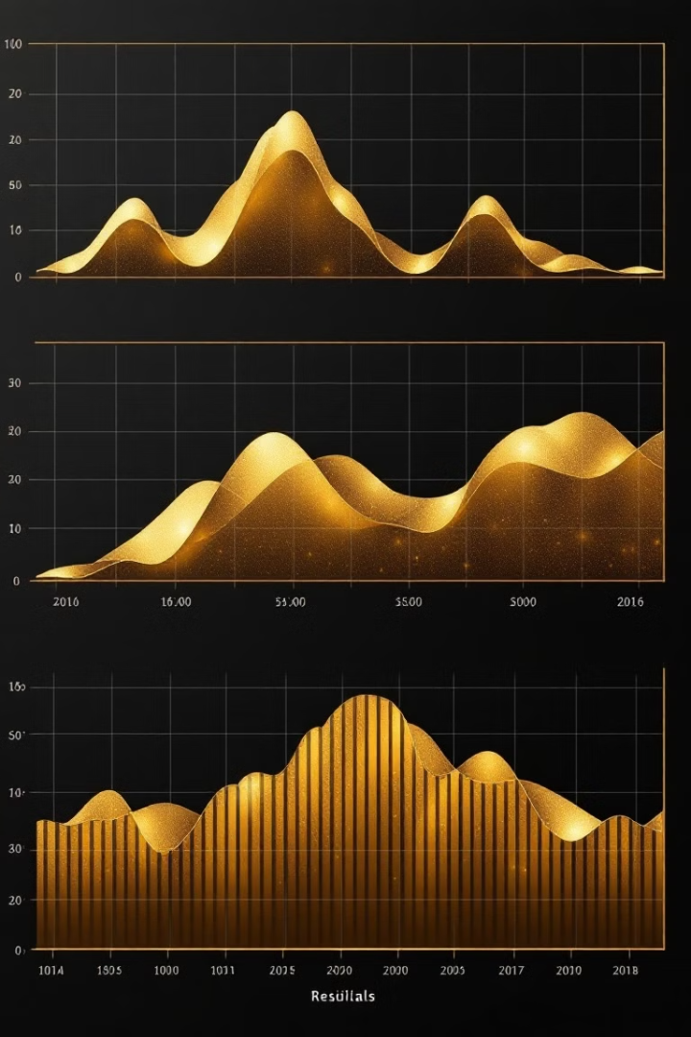



Time Series Decomposition
Trend
Overall direction of data over time
Seasonality
Recurring patterns at fixed intervals
Residuals
Unexplained variations in the data

Slide 19

Quantity Sold Forecast
ARIMA Model
Historical Patterns
Accurate short-term forecasts for inventory planning
Leverage past data to predict future sales
Confidence Intervals
Understand the range of possible outcomes

Slide 20
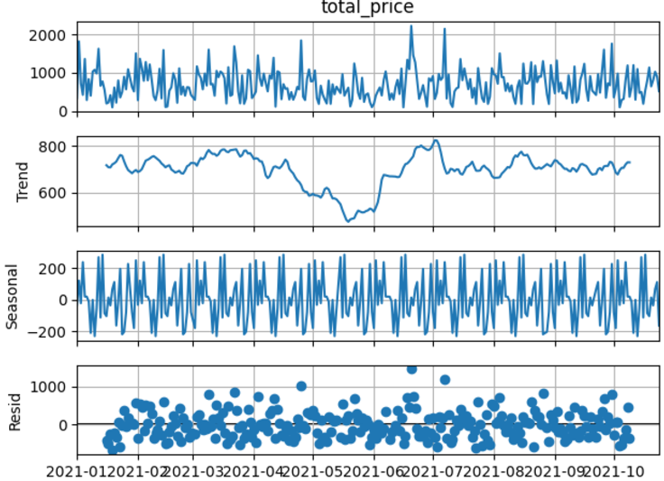
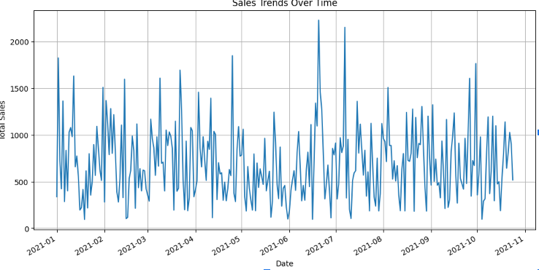

Slide 21
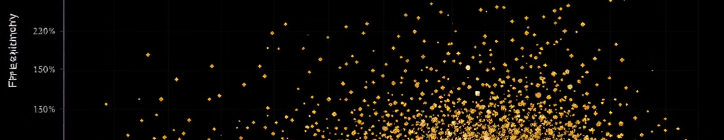



Customer Segmentation
Low Frequency, Low Spending
High Frequency, High Spending
Low Frequency, High Spending
Potential for targeted promotions
Loyal customers, focus on retention
Opportunity for increased engagement

Slide 22
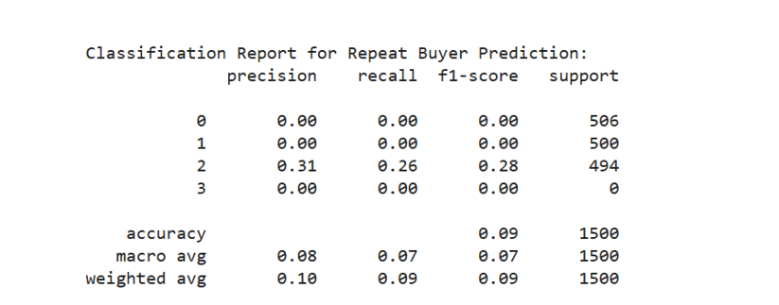
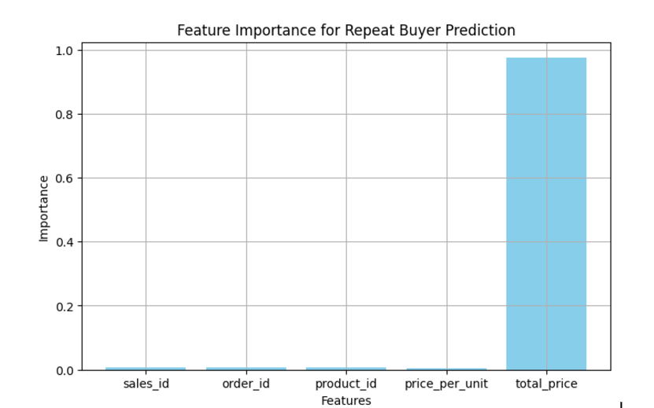
Repeat Buyer Prediction
1
Frequency
Number of purchases, key predictor
2
Monetary Value
Total spend, strong indicator
3
Recency
Time since last purchase

Slide 23
2021 Monthly Revenue Trends
March Peak
1
Highest revenue month
Seasonal Patterns
2
Recurring highs and lows
Intervention Opportunities
3
Strategies for low-performing months

Slide 24
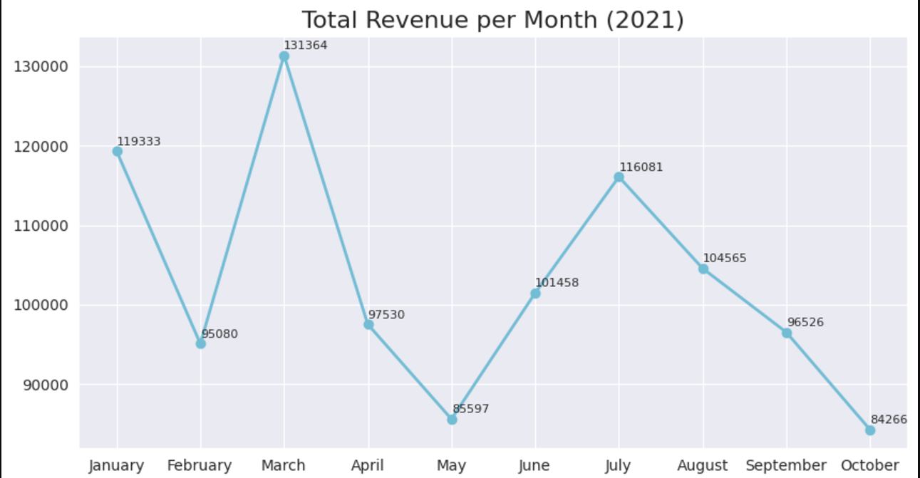

Slide 25

Revenue Distribution Analysis
60%
Most transactions fall in the lower to middle revenue range.
30%
A significant portion contributes higher revenue per transaction.
10%
A small segment of high-value transactions drives substantial revenue.

Slide 26

Sales Distribution by State
1
Top Performing States
Identified states contributing significantly more to overall revenue.
2
Opportunity Analysis
Pinpointed states with potential for growth and increased market share.
3
Targeted Campaigns
Developed state-specific marketing strategies to boost sales in key regions.

Slide 27
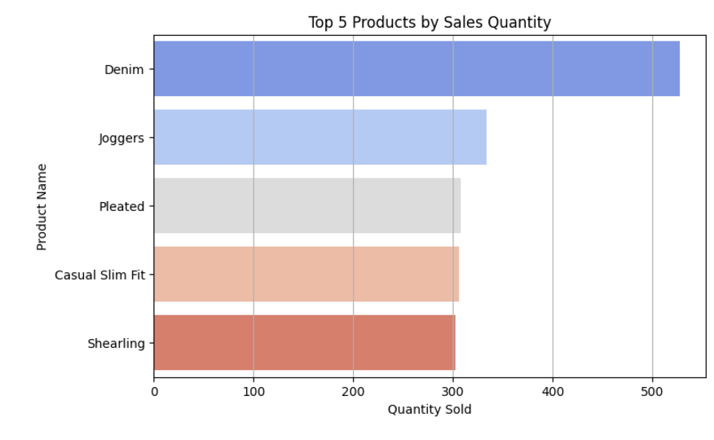
Top 5 Products by Sales Quantity
These top-selling products dominate sales, indicating a loyal customer base and strong market positioning.

Slide 28

Key Takeaways and Next Steps
Leverage High-Value Products
Seasonal Marketing
Focus marketing on key revenue generators
Align promotions with identified trends
Targeted Customer Strategies
Continuous Monitoring
Tailor approaches to specific segments
Regularly update analysis for ongoing insights

Slide 29
Thank you

